Slide 1

Python Scripting with Network
Day 8

Slide 2

Agenda
REST API
JSON API parsing with Python
Python Request Module
Python JSON API
Python Stream Uploads
Python ncclient library

Slide 3
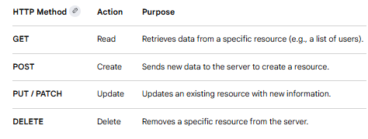
Overview of REST API
Python is one of the most popular languages for building and interacting with REST (Representational State Transfer) APIs. These APIs act as a standardized contract between different software systems, allowing them to exchange data—usually in JSON format—over HTTP.

Slide 4
JSON API for Python
Working with JSON in Python typically involves two main tasks: parsing data from an external API or building your own API that serves JSON.
json.loads(string): Decodes a JSON-formatted string into a Python dictionary or list.
json.dumps(obj): Encodes a Python object into a JSON-formatted string (useful for sending data to an API).
json.load(file) and json.dump(obj, file): Used for reading from or writing directly to .json files

Slide 5
Python Requests module
Requests is an elegant and simple HTTP library for Python, built for human beings.
The Session object allows you to persist certain parameters across requests. It also persists cookies across all requests made from the Session instance and will use urllib3’s connection pooling.
So, if you’re making several requests to the same host, the underlying TCP connection will be reused, which can result in a significant performance increase.
Whenever a call is made to requests.get() and friends, you are doing two major things. First, you are constructing a Request object which will be sent off to a server to request or query some resource.
Second, a Response object is generated once Requests gets a response back from the server. The Response object contains all of the information returned by the server and also contains the Request object you created originally.

Slide 6

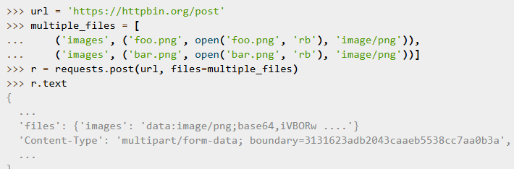
Stream Uploads
Requests supports streaming uploads, which allow you to send large streams or files without reading them into memory. To stream and upload, simply provide a file-like object for your body:
You can send multiple files in one request. For example, suppose you want to upload image files to an HTML form with a multiple file field ‘images’:

Slide 7
Python JSON Library
The Python json module is a built-in standard library tool used for parsing, serializing, and deserializing JSON (JavaScript Object Notation) data. It allows you to convert Python data structures into JSON strings or files, and vice versa.
The module revolves around four primary functions, categorized by whether you are interacting with strings or files.
json.dumps(obj): Converts a Python object into a JSON-formatted string.
json.dump(obj, fp): Serializes a Python object directly into a file.
json.loads(s): Parses a JSON-formatted string back into a Python object.
json.load(fp): Reads and deserializes a JSON file directly into a Python object.

Slide 8
Python ncclient library
In Python's ncclient library (a popular NETCONF client), "type" usually refers to the device_params argument used during connection, or the data type formats used in NETCONF RPCs (like XML).
When establishing a connection, you must pass a device_params dictionary to the manager.connect() method. This tells ncclient how to format commands for your specific networking vendor.
Common device types –
csr or iosxe (Cisco IOS-XE)
Nexus (Cisco NX-OS)
Junos (Juniper)
iosxr (Cisco IOS-XR)
Default NETCONF

Slide 9
Wrap Up
Python Automation for Network engineering
Python Network Libraries
Python Modules
Python Lambda Functions

